Slide 1


Slide 2




Warm-up and Review

Slide 3
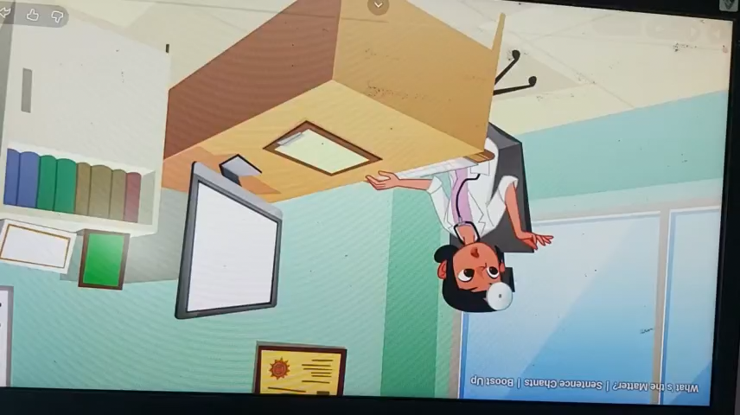

Slide 4

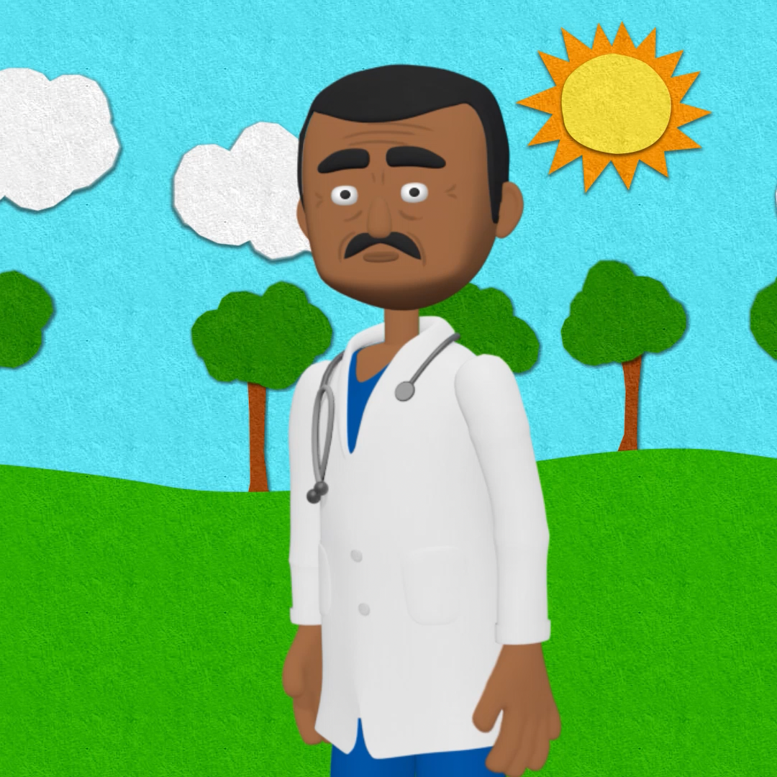


Slide 5
Check:
- runny nose
- cough
- sore throat
- toothache
- stomach ache
- headache

Slide 6
Activity 4:
Read and match.

Slide 7

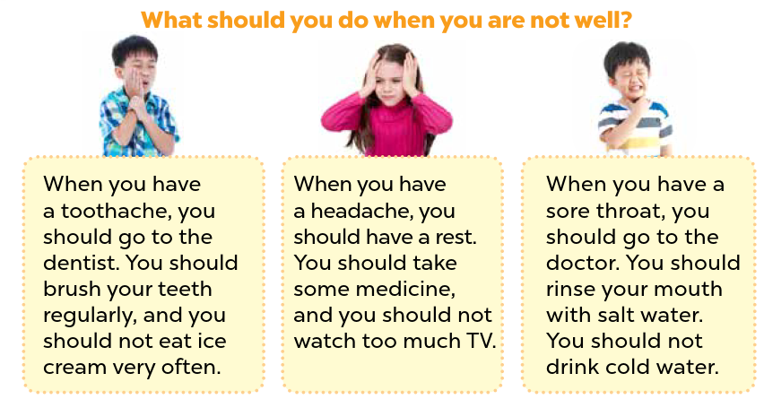
Look and read.
Notes:
Step 1: Set a time limit and ask pupils to read through the poster to get a general idea of it.

Slide 8
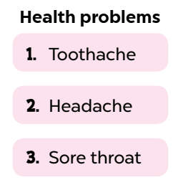
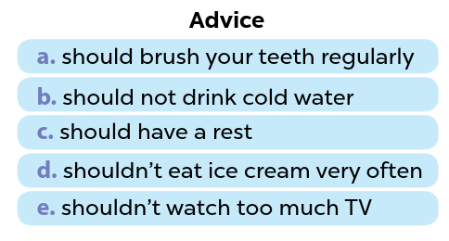
Read and match.
Notes:
Step 2: Ask pupils to read the items in the columns Health problem and Advice.
Encourage them to underline some key words that can help them find the correct answer.

Slide 9
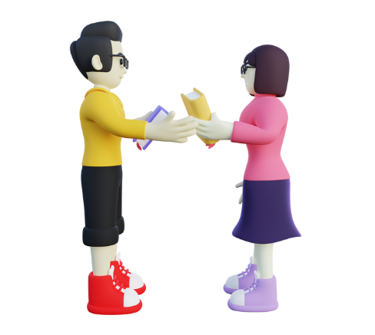
Swap your books and check your answers.
Notes:
Then pupils swap their books with a partner and check the answers.
Go around the class and offer help if necessary.

Slide 10

Read and match.
Advice
Health problems
a. should brush your teeth regularly.
1. Toothache
b. should not drink cold water.
2. Headache
c. should have a rest.
d. shouldn’t eat ice cream very often.
3. Sore throat
e. shouldn’t watch much TV.
Notes:
*Key: 1. a, d; 2. c, e; 3. b

Slide 11

Game:

Slide 12
Activity 5:
Let’s write.

Slide 13


Read these sentences.
1. Minh has a headache.
2. Linda has a toothache.
3. Linh has a sore throat.
Notes:
Step 1: Ask pupils to read the title Giving advice and sentences about Minh’s, Linda’s and Linh’s health problems. Tell pupils that they should write about 40 words.

Slide 14



Read, think and give advice.
1. Minh has a headache.
Advice
2. Linda has a toothache.
3. Linh has a sore throat.
Minh has a headache. He should/shouldn’t……………………………………………………
Notes:
Tell pupils that they should talk and then write about 40 words.
Step 2: Give pupils enough time to write their reports.

Slide 15
1. Minh has a headache.
2. Linda has toothache.
3. Linh has a sore throat.
Minh has a headache. He should have a rest. He shouldn’t watch TV or smart phone.
Linda has a toothache. She should brush her teeth regularly. She shouldn’t eat too much ice cream. Linh has a sore throat. She should take some medicine and drink warm water. She shouldn’t drink cold water.
Notes:
Step 3: Have some pupils read their completed reports aloud. Give corrections and feedback where necessary.

Slide 16
Activity 6:
Project

Slide 17


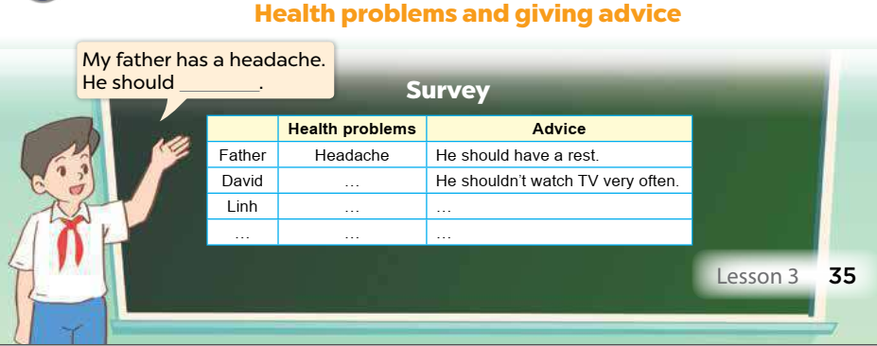
Project:
Notes:
Step 1: Point at the sample survey and explain that pupils are going to report the results of their surveys about their surrounding people’s health problems and advice they would like to give to them.

Slide 18
Look and listen.
Advice
Health problems
a. should brush your teeth regularly.
1. Toothache
b. should not drink cold water.
c. should have a rest.
2. Headache
d. shouldn’t eat ice cream very often.
3. Sore throat
e. shouldn’t watch much TV.
Notes:
Step 2: Revise some words and sentence patterns that pupils may use for their presentations.

Slide 19
Practice!!!!
Notes:
Give pupils some time to practise their presentations by themselves and within groups. Go around the classroom to monitor and offer support.

Slide 21
Fun corner and Wrap-up

Slide 22
Website: hoclieu.vn
Fanpage: https://www.facebook.com/tienganhglobalsuccess.vn/

